Slide 1
vector.name[n]
Indexing
vector.name[-n]
vector.name[c(n1, n2,..,ni)]
vector.name[-c(n1, n2,..,ni)]
vector.name[“element name”]
vector.name[ni:nj]
vector.name[-(ni:nj)]

Slide 2
Calling a function: The function name is followed by round brackets
( ) -------- Round brackets -------- Functions
Indexing a vector: The vector name is followed by square brackets
[ ] -------- Square brackets ------- Indexing elements of a vector

Slide 3

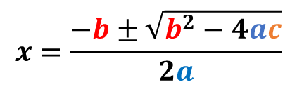
$$x=\frac{−b±\sqrt{b^{2}−4ac}}{2a}$$
List sub-setting
$$ax^{2}+bx+c=0$$
Returns
smaller list
Extracts an element
[] vs [[]]
include string variables as factors?
What is the data separator ?
Dataset name
read.table("file.name", sep =, header = , stringAsFactors = )
dataset has a header row?

Slide 4
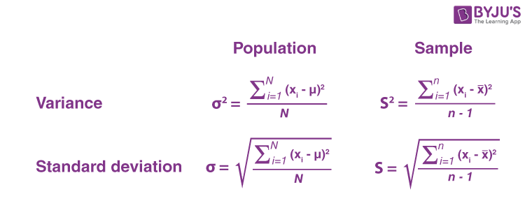
read.table("Data.csv", sep =",", header = TRUE, row.names = 1)
read.table("Data.txt", sep =" ", header = TRUE, row.names = 1)
read.table("Data.tsv", sep= "\t", header=TRUE, row.names = 1)
x₁ + x₂ + x₃ + …….. + x_{n}
n
ADJUSTS FOR
LARGER VARIABILITY

Slide 5
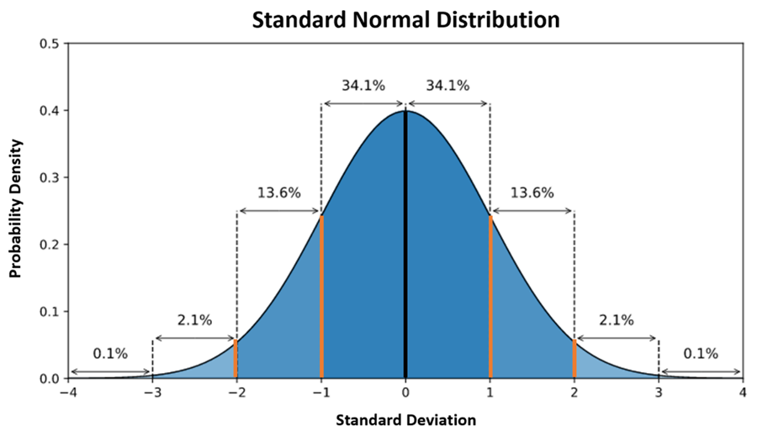

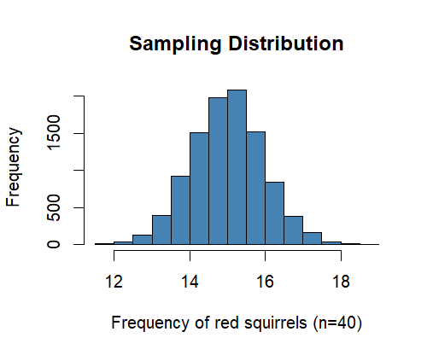
Probability Distribution

Slide 6
Original variable – Mean
Standard deviation
=
Z-scores

Slide 7

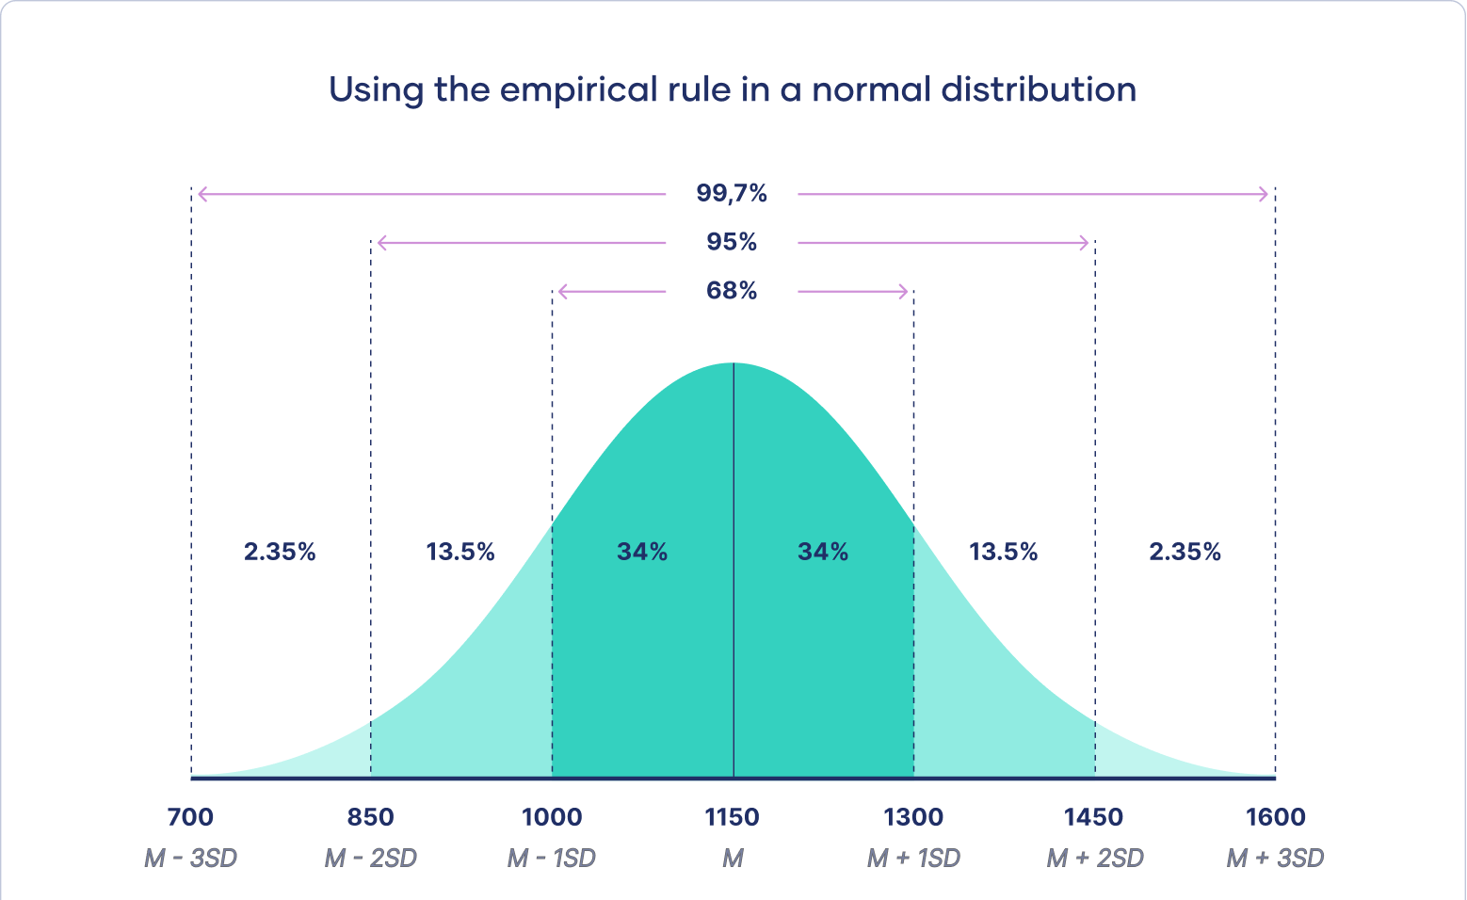

Slide 8
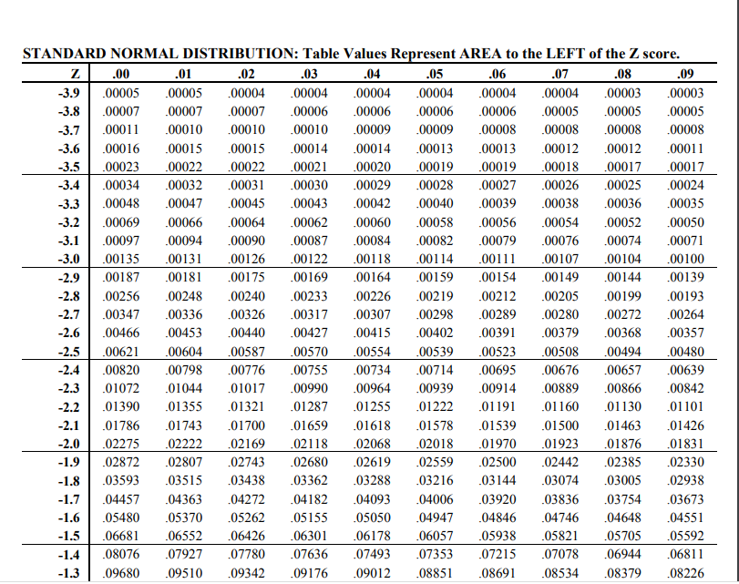
z-score = -2.53

Slide 9

R operators
Logical
Relational
Assignment
Arithmetic

Slide 10
For loop
Initiation
For every value of x
i ∈ seq
F
do y
T
body

Slide 11
Steps in data-driven decision making
Research question
Generate theory
Formulate a hypothesis
Find correct test
Conduct test
Make a decision

Slide 12

Example of two-sided hypothesis test
Hypothesis
Notation
Outcome1
Outcome2
The mean length of newborn babies in the UK is 50 cm
H₀: μ₀ = 50 cm
IF REJECTED
NOT REJECTED
The mean length of newborn babies in the UK is not 50 cm
H₁ : μ₀ ≠ 50 cm
SUPPORTED
CAN NOT BE
SUPPORTED

Slide 13
Example of one-sided hypothesis test
Hypothesis
Notation
Outcome1
Outcome2
The prevalence of anxiety disorders in US adolescents is 31.9%
H₀
IF REJECTED
NOT REJECTED
The prevalence of anxiety disorders in US adolescents > 31.9%
H₁
SUPPORTED
CAN NOT BE
SUPPORTED
σ≠

Slide 14
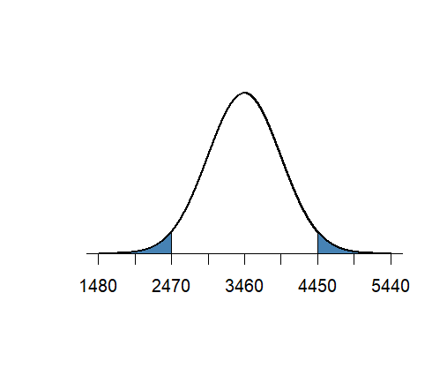
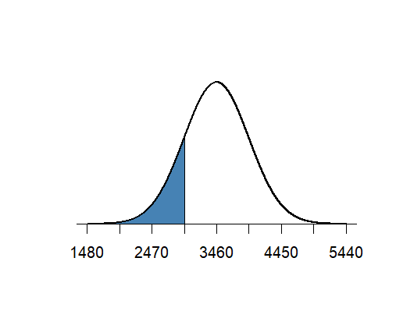
Weight at birth (g)
one-sided hypothesis test
Weight at birth (g)
Rejection region
Rejection region
Statement
H₀: μ > 3900 g
H₁: μ ≤ 3900 g
α/2
α/2
Rejection region
α
True mean
True mean

Slide 15
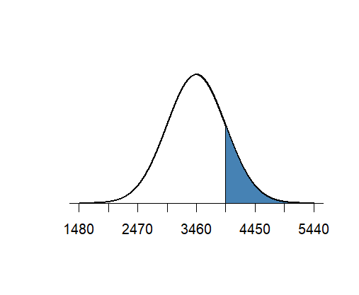
one-sided hypothesis test
Weight at birth (g)
Weight at birth (g)
H₀: μ > 3900 g
H₁: μ ≤ 3900 g
H₀: μ < 3900 g
H₁: μ ≥ 3900 g
Rejection region
Rejection region
α
α
True mean
True mean

Slide 16
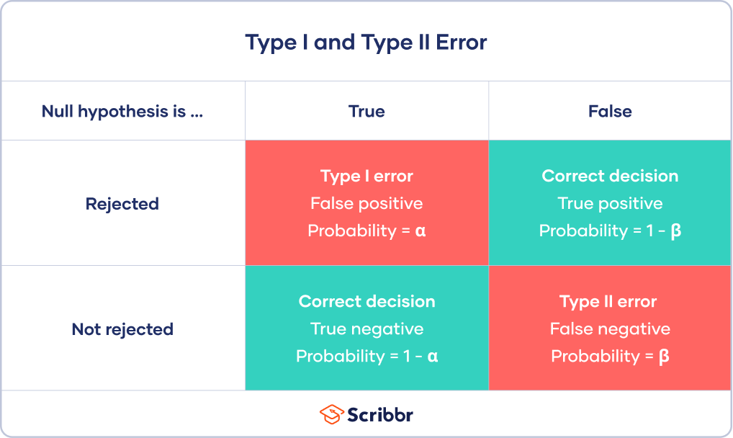
Power of the test

Slide 17
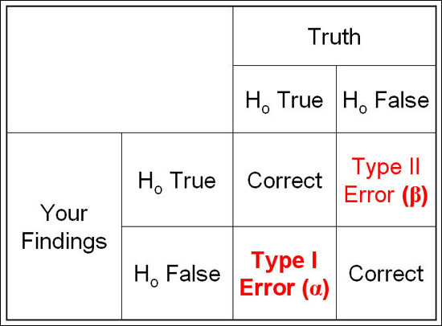

Slide 18
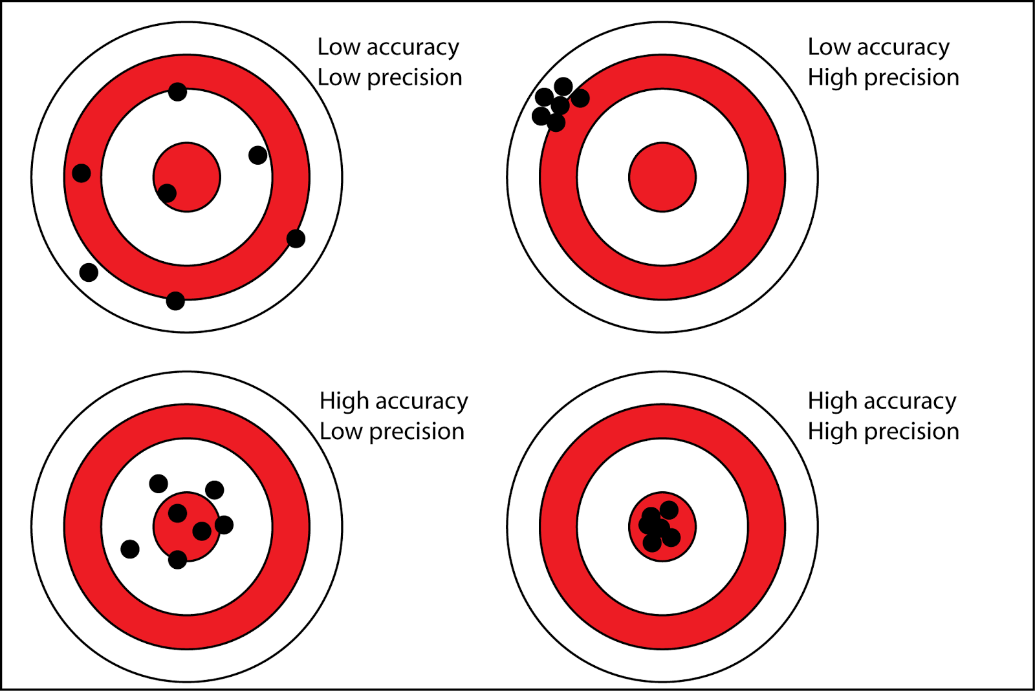

Slide 19
Population SD known: one-sample z test, two-sample z-test
Population SD unknown: one-sample t-test, two-sample t-test
d≠, ±

Slide 20
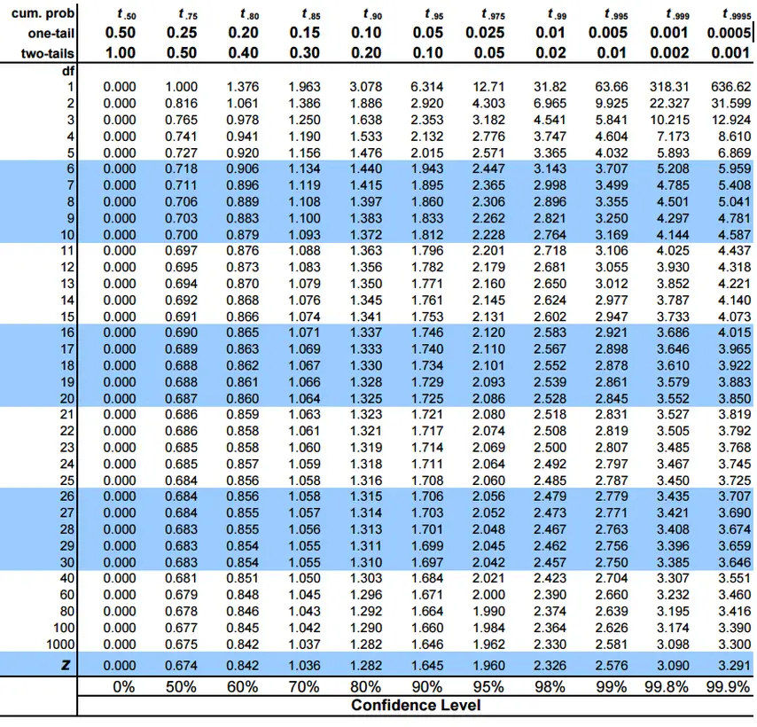

Slide 21
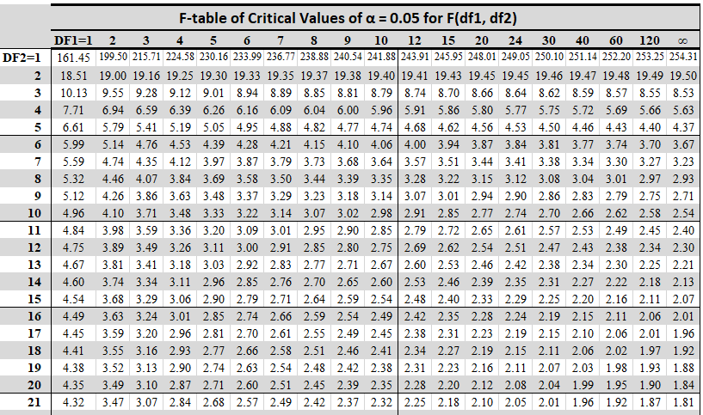

Slide 22
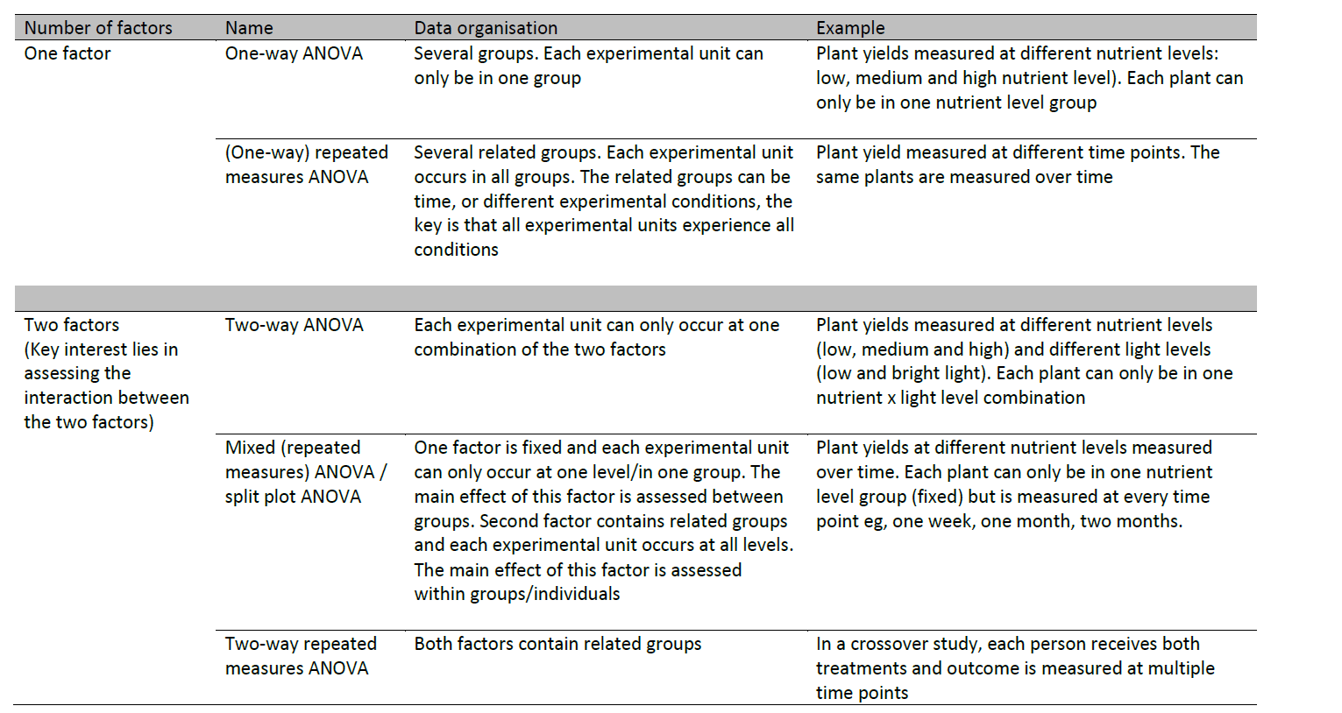
Source: Jenny Freeman, The University of Sheffield

Slide 23
Residual Assumptions
Assumption | How to Check | What to Do if Not Met
1. Residuals are normally distributed | Check histogram and QQ plots of residuals. Shapiro-Wilk's Test for normality | Consider data transformation (e.g. sqrt or log). If still not normal use a non-parametric test (Kruskall- Wallis)
2. Homogeneity of variance (The variances s² should be equal for all groups) | Residuals vs fitted plot. Levene test for equality of variances | If p-value < 0.05, consider data transformation or use the Welch test

Slide 24
